Slide 1


Slide 2
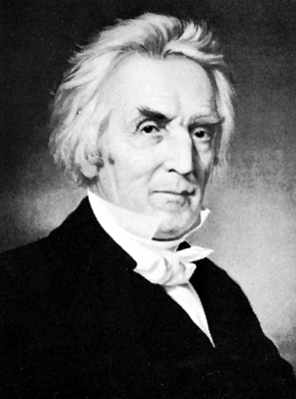
Christian
Or
Campbellite

Slide 3
Why a very important topic?
There is so much confusion among people today concerning this topic
Every member of the Body of Christ must be ready to give an answer (1 Peter 3:15)
We must help people understand what the Bible teachers concerning this topic

Slide 4

Please Consider The Following Passages Before Our Lesson
Acts 17:11
1 Thessalonians 5:21
1 John 4:1
John 7:17
James 1:22

Slide 5

OVERVIEW OF OUR LESSON
Our Bible authority in relation to our topic under consideration
Statements used to refer to christians as Campbellites
Some reasons why people refer to us as Campbellites
Reasons why we are Christians and NOT Campbellites

Slide 6
OUR BIBLE AUTHORITY
In order to give a biblical answer to this question we MUST consider the topic of Bible authority
Colossians 3:17; 1 Peter 4:11; Titus 2:1; 2 Timothy 1:13
CHRISTIAN
OR
CAMPBELLITE?

Slide 7
Let us consider a few statements on which people refer to Christians as Campbellites

Slide 8
The following information was taken from Brother Curtis Cates’ lecture back in 2006 at the Spiritual Sword Lectures:
The attempt to belittle the restoration plea is not just recent. C.R. Nichol fifty years ago wrote of a sectarian preacher who, in a debate with brother E.A. Elam (which debate brother Nichol heard at eleven years of age), called brother Elam and his brethren “Campbellites.” Mr. Ogle charged,

Slide 9
These people whom Mr. Elam represents, with himself, make great claims to being the church Christ established, whereas the facts are that as a church they are some eighteen hundred years too young to be that church. Mr. Alexander Campbell is the ecclesiastical father of the church of which they are members, and it still has on its swaddling clothes. They have as their slogan the words of a Mr. Thomas Campbell, the father of their religious sect (Nichol, 768-769).
Cates, A. Curtis, “The Church of Christ Did Not Begin with the Restoration Movement” Spiritual Sword Lectures October 15-19, 2006 (Sain Publications: Pulaski, TN), p. 107

Slide 10
Notice the following information from a Baptist preacher:
In his 101 questions for Campbellites, pastor A.A. Davis of the First Baptist Church of Nowata, OK., asked the question: What are Campbellites? His answer was: These are known as "The Church of Christ," or "The Disciples of Christ," which believe that Water Baptism is essential to salvation in Jesus Christ.
http://www.biblebelievers.com/Davis1.html

Slide 11
A Baptist publication called Calvary Contender (June 15, 1999) chastised the magazine Christianity Today for accepting an ad from Harding University of Searcy, AR. They argued that Harding is a “Campbellite” church of Christ school. They went on to say that the church of Christ is considered a cult in some regards because it allegedly teaches a “works salvation”.
http://www.christiancourier.com/articles/822-alexander-campbell-and-christs-church

Slide 12

Wikipedia Encyclopedia
Campbellite refers to any of the religious groups historically descended from the Restoration Movement, a religious reform movement in the early 19th century in the United States. The major groups are: The churches of Christ, the Christian church (Disciples of Christ), the Independent Christian churches/churches of Christ, the churches of Christ non-institutional.
http://en.wikipedia.org/wiki/Campbellite

Slide 13

Wayne Jackson, “Alexander Campbell and Christ’s church”
Robert Owen, the English “Free-thinker” who came to America to establish a movement of “social reform,” was, according to A.B. Barret, the first man to employ the epithet, “Campbellite” (The Shattered Chain, 32). Those who so enjoy utilizing this misnomer are indebted to infidelity for it.
http://www.christiancourier.com/articles/822-alexander-campbell-and-christs-church

Slide 14
BTSOP STUDENTS
Some of our students, while knocking doors, were called “Campbellites”.
One of our graduates had a discussion with another preacher concerning the matter under consideration. This preacher argued that members of the church of Christ should be called “Campbellites” because Alexander Campbell started the church of Christ.

Slide 15
All of the information we have considered reflects the ignorance that abounds in people’s minds concerning the topic under consideration
No wonder people perish for lack of knowledge!
Hosea 4:6; Isaiah 5:13

Slide 16

Why are we called “Campbellites”?

Slide 17
MORE REASONS TO CONSIDER
People have no respect for the authority of the Scriptures (Colossians 3:17; 2 Timothy 1:13; 1 Peter 4:11).
People have decided to accept what others say about this matter and not what the Bible teaches (Jeremiah 6:16).
Some of our members are quoting more what Alexander Campbell said than what the Bible teaches (1 Peter 4:11; Titus 2:1).

Slide 18
MORE REASONS TO CONSIDER
People just cannot accept that we are Christians only. They refuse to accept the evidence that is before them.
People just want to ridicule members of the body of Christ.
Others simply do not have knowledge of what the Scriptures teach about who a Christian is.

Slide 19
Let us consider a few reasons why we are NOT “Campbellites” but Christians

Slide 20
We are Christians NOT “Campbellites” because we follow Jesus Christ and not Alexander or Thomas Campbell

Slide 21
Every faithful Christian will follow the doctrine of Christ and the Apostles
The word “Christian” denotes and describes a follower of Christ, not Alexander Campbell.
We are commanded to follow the doctrine of Christ not men (Matthew 15:7-9; 2 John 9-11; Acts 2:42; 2 Thessalonians 2:15)
We follow Christ and NOT Alexander Campbell because Jesus is the way to Salvation (Acts 4:12; John 10:9; 14:6)

Slide 22
We are Christians NOT “Campbellites” because this is what the Bible calls us!

Slide 23

We Are Christians NOT Campbellites!
“And when he had found him, he brought him to Antioch. So it was that for a whole year they assembled with the church and taught a great many people. And the disciples were first called Christians in Antioch” (Acts 11:26)

Slide 24
We Are Christians NOT Campbellites!
“Then Agrippa said to Paul, You almost persuade me to become a Christian”
(Acts 26:28)

Slide 25
We Are Christians NOT Campbellites!
“Yet if anyone suffers as a Christian, let him not be ashamed, but let him glorify God in this matter” (1 Peter 4:16)

Slide 26
The Bible Also Refers To Us As…
There is NO passage
In the Bible where we
Are called
“Campbellites”
Saints (Ephesians 1:1)
Disciples (Acts 14:22)
Members of the family of God (Ephesians 2:19)
Children of God (John 1:12-13)
Sojourners and Pilgrims (1 Peter 2:11)
A holy nation (1 Peter 2:9)

Slide 27
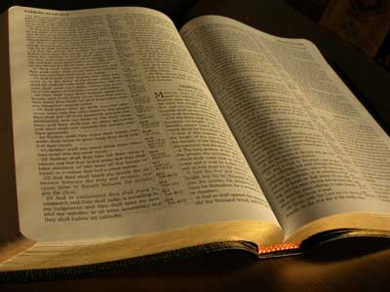
We MUST follow what the Bible teaches IF we want to be pleasing to God!
1 Peter 4:11; Titus 2:1; 2 Timothy 1:13; Colossians 3:17

Slide 28
We are Christians NOT “Campbellites” because Jesus Christ established His church, of which we are members, and NOT Alexander Campbell!

Slide 29
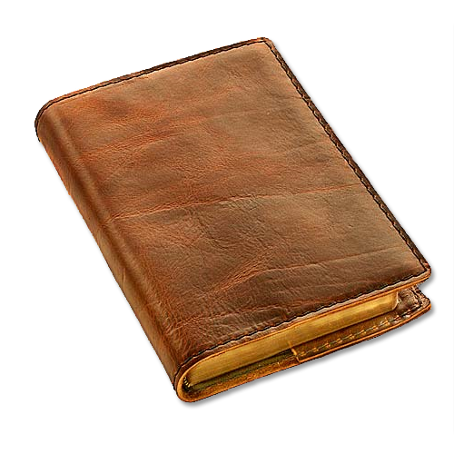
JESUS CHRIST ESTABLISHED HIS CHURCH
Matthew 16:18
Acts 20:28
1 Peter 1:18-20
Ephesians 1:4
Ephesians 1:22-23
Ephesians 5:23

Slide 30
HIS CHURCH WAS ESTABLISHED ON PENTECOST DAY
According to Prophecy (Isaiah 2:1-4)
The location of the establishment was Jerusalem (Acts 2:1-47)

Slide 31
We are Christians NOT “Campbellites” because we have been baptized into the Body of Christ, NOT Alexander Campbell!

Slide 32
Those who obey the gospel are added to the Body of Christ!
Hear (Romans 10:17; Acts 18:8; 1 Cor. 15:1-4)
Believe (Acts 18:8)
Repent of sins (Acts 2:38; 17:30)
Confess Christ as the Son of God (Romans 10:9-10)
Be baptized for the forgiveness of sins (Acts 2:38; 22:16)
Live a faithful life (Revelation 2:10; Philippians 2:12)
Acts 2:41, 47; Galatians 3:27; 1 Cor. 12:13
CHRIST

Slide 33
The biblical evidence we have considered is clear. According to the Bible, God’s final authority, we are called CHRISTIANS, NOT Campbellites!
Thank God for this name!

