Slide 1
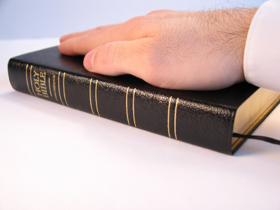

Slide 2
Back To The Bible Concerning Our Faithfulness To God
By Willie Alvarenga

Slide 3
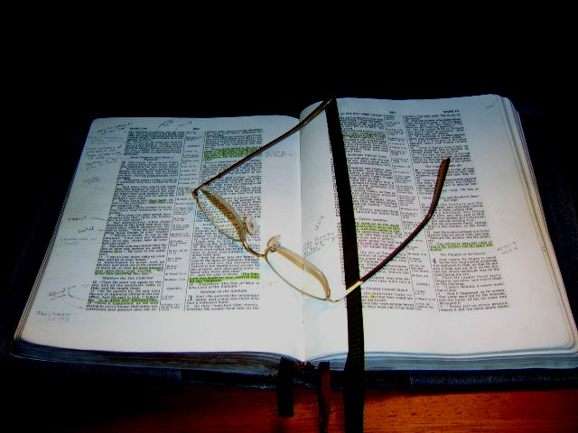
Points To Consider In This Lesson:
Our present reality concerning our faithfulness to God
The command to be faithful
The why of faithfulness
The how of faithfulness

Slide 4
Our sad reality concerning faithfulness
Many Christians ignore Hebrews 10:24-25
Many Christians ignore 2 Timothy 2:15
Many Christians ignore 2 Peter 3:18
Many Christians ignore 1 Corinthians 15:58
Many Christians ignore 1 Thessalonians 5:17

Slide 5
Our sad reality concerning faithfulness
Many Christians ignore Revelation 2:10
Many Christians ignore Hebrews 13:17
Many Christians ignore Mark 16:15
Many Christians ignore John 13:34-35
Many Christians ignore Mark 12:30

Slide 6
All of these things reveal our unfaithfulness to God

Slide 7
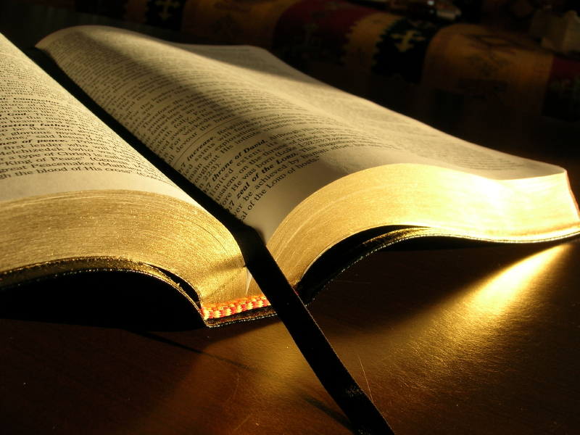
Let Us Consider The Command To Be Faithful

Slide 8
God Commands Us To Be Faithful:
He expects us to be faithful in His doctrine (I Corinthians 4:6; II John 9-11; Revelation 22:18-19; Colossians 3:17).
He expects us to be faithful in our worship to Him (John 4:23-24; Colossians 3:17).

Slide 9
God Commands Us To Be Faithful:
He expects us to be faithful in our preaching of His Word (Jeremiah 23:28)
He expects us to be faithful in holiness (I Peter 1:15-18; Leviticus 11:44; Romans 13:14; Galatians 5:16; I Peter 2:11; I John 2:15-18; James 4:4)
He expects us to be faithful even in the midst of difficulties (Revelation 2:10; 3:5; Acts 8:4; Philippians 1:29)

Slide 10
God Commands Us To Be Faithful:
He expects us to be faithful in our love for one another (John 13:34-35; Romans 12:9)
He expects us to be faithful in the study of His Word (II Timothy 2:15)

Slide 11
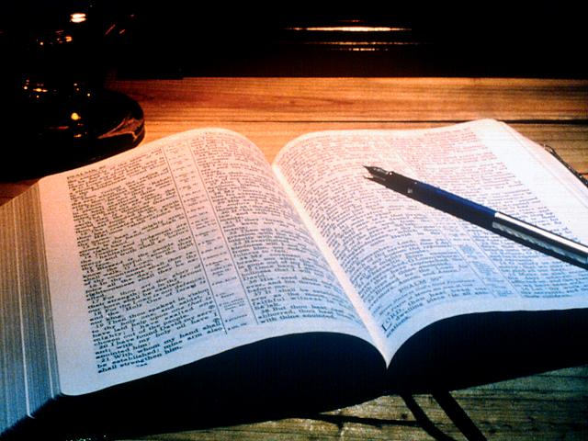
Let Us Consider The “Why” Of Faithfulness

Slide 12

We must be faithful to God because He deserves our faithfulness.

Slide 13
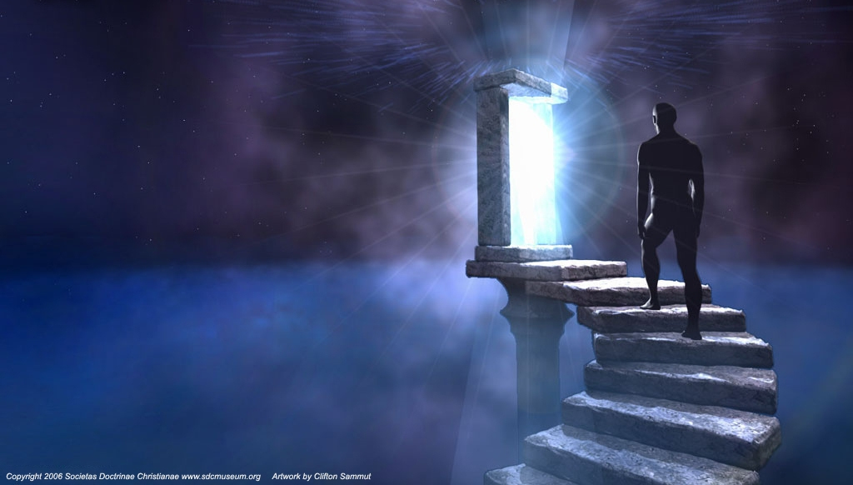
We must be faithful to God because our faithfulness helps us to bring others to Christ.

Slide 14

We must be faithful to God because our faithfulness will bring us great rewards.

Slide 15
Notice The Rewards:
  We become great examples to others (Matthew 5:13-16).
  God will be glorified through our faithfulness (Matthew 5:16).
  We will be showing God that we love Him (John 14:15).

Slide 16
Notice The Rewards:
  We will receive the crown of life and righteousness (II Timothy 4:7-8; James 2:12; Revelation 2:10).
  Our names will be in the lamb’s book of Life (Revelation 20:14-15)
  We will be in heaven some day (Matthew 7:21; Hebrews 5:8-9).

Slide 17
Let Us Consider The “How” Of Faithfulness

Slide 18
Is faithfulness possible for us as Christians?
Can we live the Christian life the way God would have us to live?

Slide 19


We can remain faithful to God by practicing the following:

Slide 20
By resisting the Devil (James 4:7).
By studying and practicing the Word of God (Psalm 119:9, 11; James 1:22).
By praying to God continually (Matthew 26:41; I Thessalonians 5:17)

Slide 21
By avoiding evil companions (I Corinthians 15:33; Proverbs 1:10)
By not loving the world (I John 2:15-17)
By keeping your mind busy on pure thoughts (Philippians 4:8)
By keeping in mind the terrible consequences of not being faithful (Romans 6:23)

Slide 22
Faithfulness is possible; Therefore, let us go back to the Bible, and be faithful to our Heavenly Father!

