Slide 1
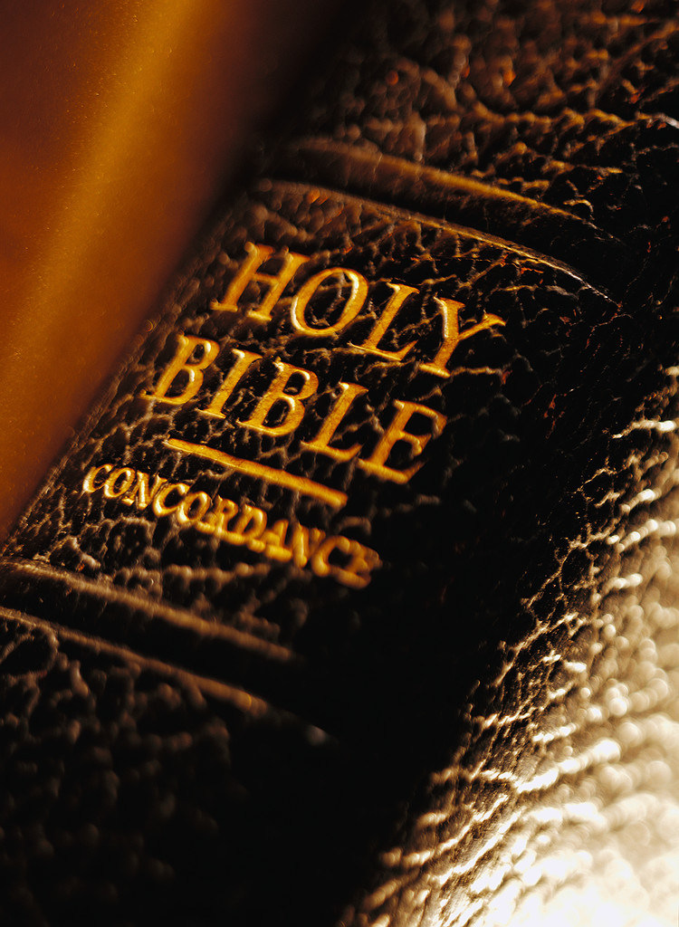
Back To The Bible Concerning How To Be Saved From Sin
By Willie Alvarenga

Slide 2
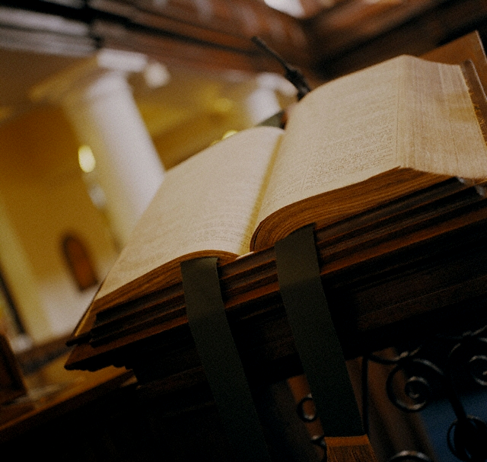
Usted Puede Saber Que Hacer Para Ser Salvo
Willie Alvarenga

Slide 3


Un Llamado A Estudiar La Biblia
Hechos 17:11
I Tesalonicenses 5:21
I Juan 4:1
Juan 7:17

Slide 4

En Esta Leccion Consideraremos Los Siguiente:
Nuestra presente condicion en cuanto al tema bajo consideracion
Lo que la Biblia enseña sobre la salvacion
La necesidad de obedecer hoy y no mañana

Slide 5
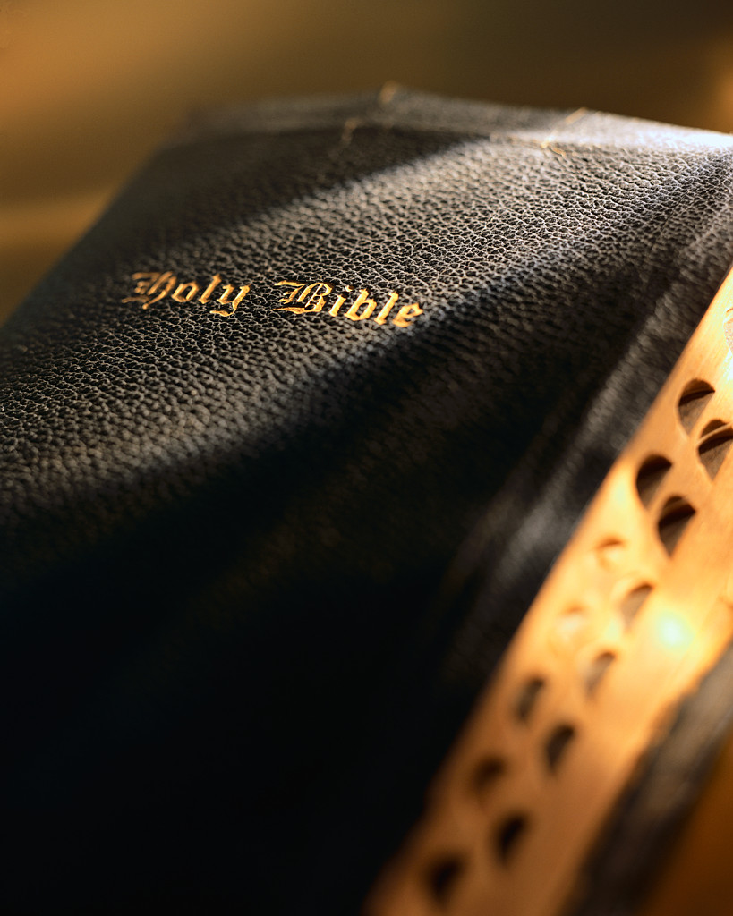
Why Must People Go Back To The Bible Concerning What A Person Must Do To Be Saved From Sin?

Slide 6
There is so much confusion concerning salvation

Slide 7

Accept Jesus as your personal savior
You must pray Jesus into your heart
Faith alone will save you
Just confess Jesus as your savior and you will be saved

Slide 8
Accept the Lordship of Jesus and you will be saved
Touch the radio and pray, and you will be saved
Send your contribution and the Lord will give you salvation
There is nothing you can do to be saved from sin, Jesus did it all
Flip your headlights on and off to show that you are being saved

Slide 9
We are commanded to teach what God says; not what man says

Slide 10
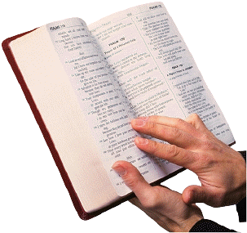
The Bible’s Teaching Concerning What A Person Must Do To Be Saved From Sin.

Slide 11

John 8:32; Ephesians 3:4; 5:17; I John 5:13
Man Can Understand God’s Will Concerning Salvation

Slide 12
The Bible Teaches That Jesus Is The Only Way To Be saved.

Slide 13
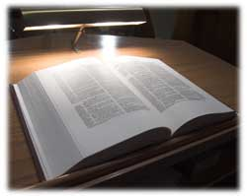
John 10:9 He is the door to salvation
John 14:6 He is the way to salvation
Acts 4:12 There is no salvation outside of Christ
Romans 8:1 Salvation is only in Christ
II Corinthians 5:17 New life is in Christ
I John 5:11 Eternal life is in Christ
II Timothy 2:10 Salvation in Christ
Ephesians 1:7 Redemption is in Christ
Hebrews 5:9 Jesus is the author of eternal salvation
John 1:29 Jesus is the lamb of God who takes away the sin of the world
I Peter 1:18-20 We are redeemed by His blood

Slide 14
The Bible Teaches That God Has A Plan To Save Man From His Sins.

Slide 15

This plan is call the gospel of Christ

Slide 16
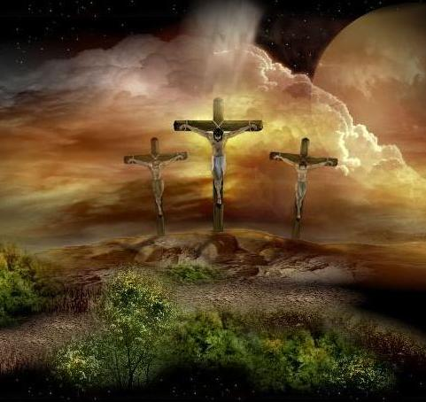
What is the gospel of Christ?

Slide 17
The gospel is the message that Jesus sent His disciples to preach (Mark 16:15).
The gospel is the power of God unto salvation (Romans 1:16).
The gospel consist in the death, burial and resurrection of Christ (I Corinthians 15:1-4; Romans 6:1-4).

Slide 18
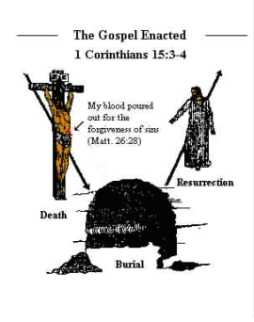

Slide 19
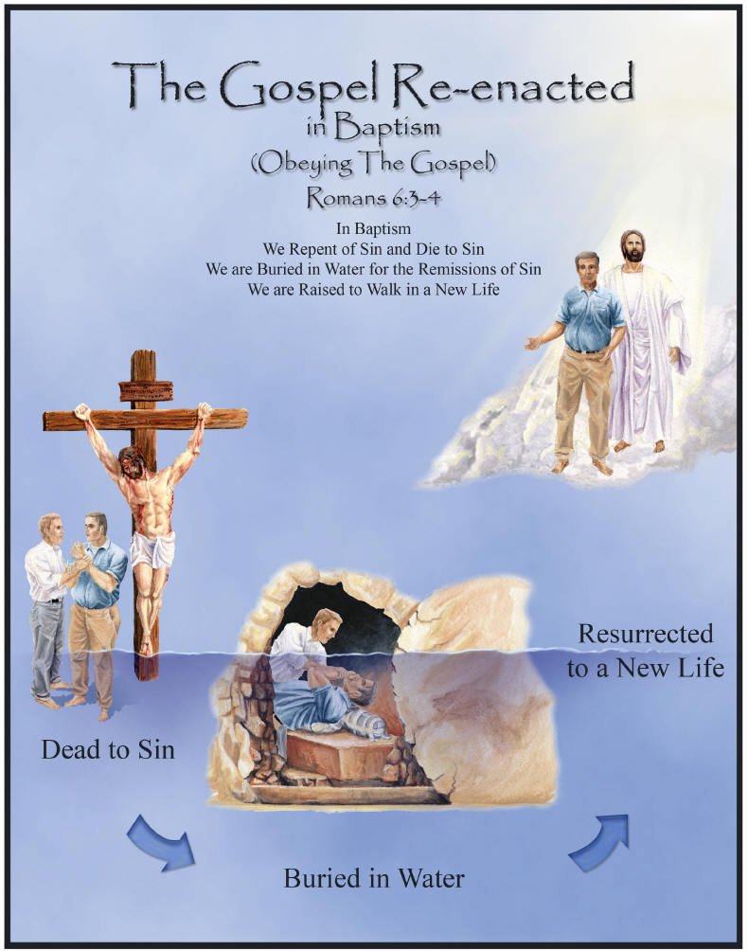

Slide 20
How Were Man Saved From Sin In The Early Century?

Slide 21
According to the Book of Acts:
The gospel was preached by the apostles and the early Christians (Acts 2:22-25, 32, 36-41)
Man heard the gospel of Christ (Acts 2:37)
Man believed in the gospel (Acts 2:37; 8:12; 18:8)
Man repented from his sins (Acts 2:38; 3:19; 17:30)
Man confessed Christ as the Son of God (Acts 8:37; Romans 10:9-10)
Man was baptized for the forgiveness of his sins (Acts 2:38; 22:16)

Slide 22
After obedience to the gospel was done, they continued faithful unto death (Acts 2:42; Revelation 2:10)

Slide 23
What Are Blessings When You Obey The Gospel?

Slide 24
The Bible teaches that all spiritual blessings are in Christ
(Ephesians 1:3)

Slide 25

Forgiveness of sins (Acts 2:38; 22:16; Ephesians 1:7; Colossians 1:14)
Reconciliation (Ephesians 2:13-16)
A place where there is no condemnation (Romans 8:1)
A new life (II Corinthians 5:17; Romans 6:4)
Hope of eternal life in heaven (Titus 1:2; I John 5:11; John 14:1-3)
A privilege to be part of the family of God (Ephesians 2:19; John 1:11-13)

Slide 26
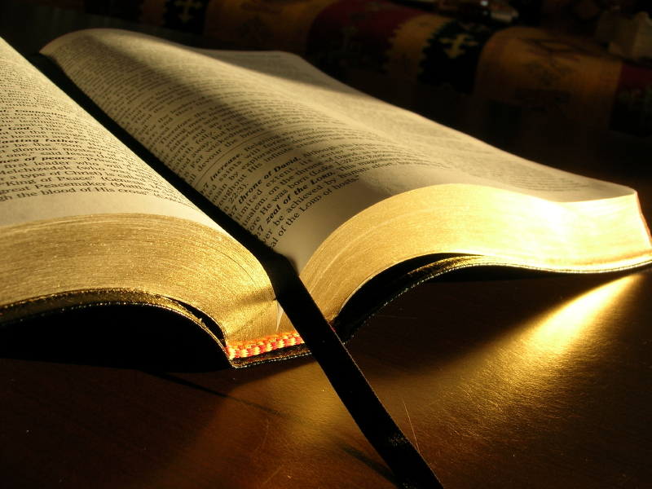
Why must you obey the gospel today?

Slide 27
Two reasons to consider:
You may depart from this life any moment (James 4:14; Job 14:1-2; I Samuel 20:3; II Samuel 14:14).
Jesus may come again any moment (Matthew 24:36, 44; I Thessalonians 5:1-2).

Slide 28
Please obey the gospel today before it is eternally too late

